Slide 1

INSTITUTE - UIE
DEPARTMENT- ACADEMIC UNIT-2
Bachelor of Engineering (Computer Science & Engineering)
Subject Name: Introduction to Problem Solving
Code:22CSH-101
INTRODUCTION TO SWITCH STATEMENT
DISCOVER . LEARN . EMPOWER

Slide 2

Course objectives
OBJECTIVES
The course aims to provide exposure to problem solving with programming
The course aims to raise the programming skills of students via logic building capability
With the knowledge of C language students would be able to model real world problems

Slide 3


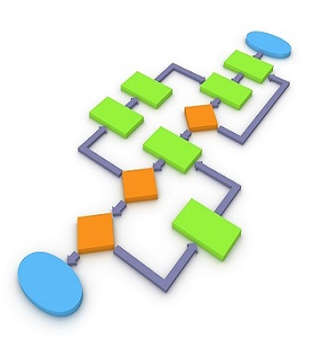
Course Outcomes
CO Number | Course Outcome
CO1 | Remember the concepts related to fundamentals of C language, draw flowcharts and write algorithm/pseudocode.
CO2 | Understand the way of execution and debug programs in C language.
CO3 | Apply various constructs, loops, functions to solve mathematical and scientific problem.
CO4 | Analyze the dynamic behavior of memory by the use of pointers.
CO5 | Design and develop modular programs for real world problems using control structure and selection structure.

Slide 4

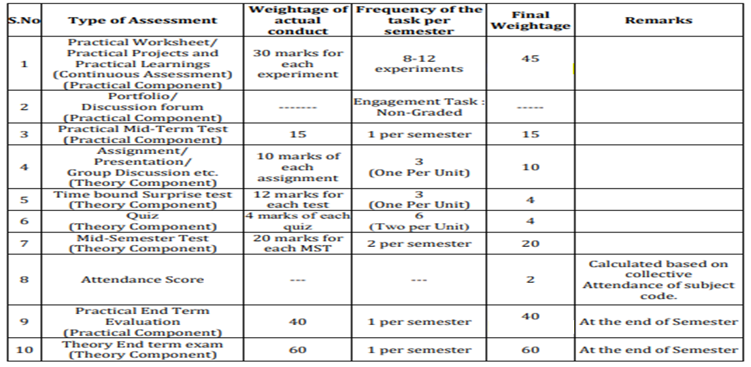
COURSE SCHEME

Slide 5
WHY
While working with multiple tasks
When we have different choices based problems
WHY ?
WHEN ?
HOW ?
WHEN
So when you have multiple options available and you need to decide one of all according to requirement match
HOW
It has its own structure where multiple switch cases are used. When a particular match is found with a case, that particular case will execute of all other.

Slide 6
WALKTHROUGH
To what and why of switch statement
To the syntax representation of switch
To the execution of the switch statement
LEARNING DIRECTIONS
You would be able to apply the knowledge in solving multi-task problems and menu driven programs
RESOURCES &
LEARNING DIRECTIONS

Slide 7
Sometimes we work with different options
Based on those different options there are multiple tasks
Thus, switch statement can be used where multiple tasks are involved
It takes a variable and test the value of that variable with the multiple cases
There are 4 switch cases and suppose I gave value 4, the value will matched with each switch case and the matching case will execute ( which is case 4)
SWITCH
STATEMENT
Let’s cover the why and when of switch
Switch case 1
Switch case 2
Switch case 3
Switch case 4

Slide 8
switch (expression)
​ {
case value1:
// statements
break;
case value2:
// statements
break;
.
.
.
default:
// default statements
}
SWITCH
STUCTURE
Let’s go through the Structure of switch statement
Default statement is optional

Slide 9
switch (exp) let int exp = 2
​ {
case 1:
// statement 1
break;
case 2:
// statements 2
break;
case 3:
//statement 3
default:
statements
}
switch (exp) let int exp = 2
​ {
case 1:
// statement 1
case 2:
// statements 2
case 3:
//statement 3
default:
statements
}
Why break ?
Break will stop the control after case 2 & statement 2 will be printed only
All cases will execute after the matching case
WITH BREAK

Slide 10
Output:
Default: value is: 2
Explanation: Since in the above program example user gave value of n as 2 but the expression inside switch is evaluated to 4 (n+2) so, default case executed.
int n=2;
switch(n+2)
{
case 1:
printf("Case1: Value is: %d", n);
case 2:
printf("Case1: Value is: %d", n);
case 3:
printf("Case1: Value is: %d", n);
default:
printf("Default: Value is: %d", n);
}
LET’S LEARN EXAMPLE EXECUTION

Slide 11
char c='b';
switch (c)
{
case 'd':
printf ("Case D ");
break;
case 'b':
printf ("Case B");
break;
case 'c':
printf ("Case C");
break;
case 'z':
printf ("Case Z ");
break;
default:
printf ("Default ");
}
Output:
Case B
A case can be written with characters as well, like case ‘a’ or case ‘A’ is valid
An expression inside switch can be a integer value or a character value

Slide 12
SUMMARY…..
We covered how and why of switch statement
The structure of switch through its syntax and its building cases components
Example executions of switch statement to gain better insight of concept

Slide 13
FREQUENTLY ASKED QUESTIONS
THINK AND ANSWER BELOW QUESTIONS
Why switch statement is required ?
Is it necessary to have a default statement inside switch ?
Why is the use of break ?
Can you design a menu driven program using switch ?
PROGRAMS
C program to read weekday number and print weekday name using switch.
C program to check whether a character is VOWEL or CONSONANT using switch statement.
C program to design calculator with basic operations using switch.
C program to check whether number is EVEN or ODD using switch.
5. Write a menu driven C program that will build a calculator.

Slide 14
1. Which of the following cannot be checked in a switch-case (C programming)
A. Character
B. Integer
C. Float
D. enum
2. What will be the output of following program?
#include <stdio.h>
void main ()
{
int a=10;
switch(a) {
case 5+5:
printf("Hello\n");
default:
printf("OK\n");
}
}
UTILISE YOUR KNOWLEDGE TO ANSWER
Let us see how much you have learned from the lecture and how effectively you can apply your knowledge…!!

Slide 15
3. Can we use string value/variable in switch test condition?
switch(test_expression)
{
case VALUE1:
case VALUE2:
case VALUE3:
/*statements block 1*/
break;
case VALUE4:
case VALUE5:
/*statements block 2*/
break;
}
A. Yes
B. No
UTILISE YOUR KNOWLEDGE TO ANSWER
Let us see how much you have learned from the lecture and how effectively you can apply your knowledge…!!

Slide 16

DISCUSSION FORUM
Utilize your knowledge and think of a real-world application that you can build using a switch case and also that can contribute something good to the towards the real-world problem solving.
We have used and studied else if ladder which is also a multiway decision maker than what u think why switch? what other pros we can have with using a switch statement?

Slide 17
Reference Books
[1] Kanetkar, Y. (2010). Let us C. 15th ed.
[2] Thareja Reema (2014) Programming in C. 2nd ed.
[3] Zed A. Shaw, Learn C the Hard Way’
Reference Website
[1] https://www.guru99.com/c-switch-case-statement.html
[2] https://www.programiz.com/c-programming/
c-switch-case-statement
[3] https://www.tutorialspoint.com/cprogramming/
switch_statement_in_c.html
Online Courses
https://www.classcentral.com/course/swayam-introduction-to-programming-in-c-2486
https://www.coursera.org/learn/c-for-everyone
REFERENCES
BOOKS
WEBSITES
COURSES

Slide 18
THANK YOU….

